Slide 1








Netflix 2015:
Setting the Stage for Our Grandest Expansion Yet!

Slide 2






Today's Agenda
1
Welcome and overview of the meeting's purpose
Deep dive analyses and Data insights
Recommendation and Potential strategies for implementation

Slide 3





THE PATH WE TOOK
PROJECT
INCEPTION
CUSTOMER
RETENTION
PROJECT
INCEPTION
GENDER
ANALYSIS
CUSTOMER CALL
SUPPORT
AGE & EMAIL
SUBSCRIPTIONS
suggestions

Slide 4
86.7%
Our customer loyalty is unparalleled
and soaring!

Slide 5
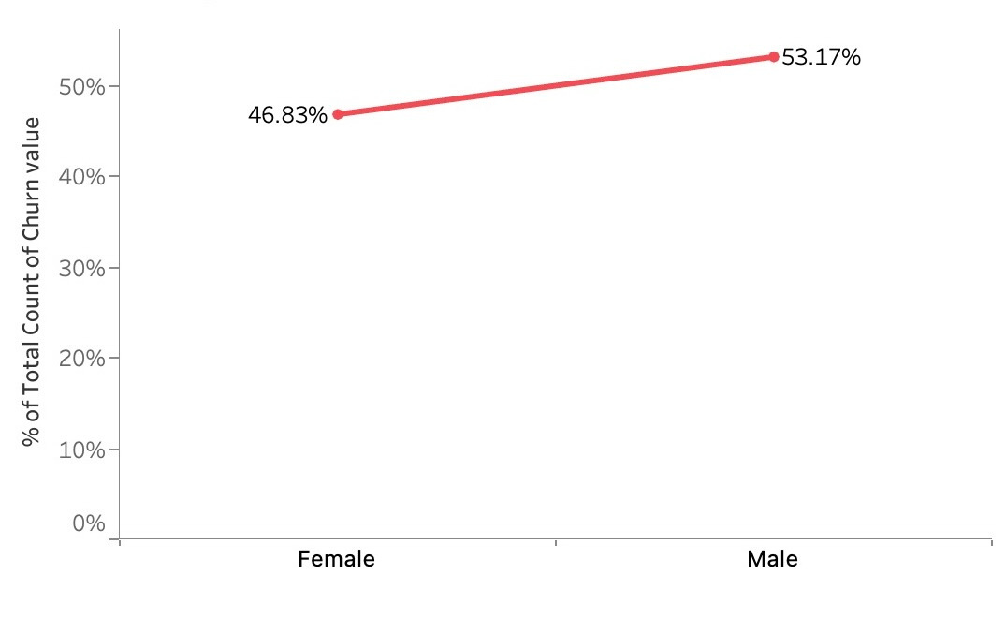
gender analysis
Gender representation is well-balanced

Slide 6
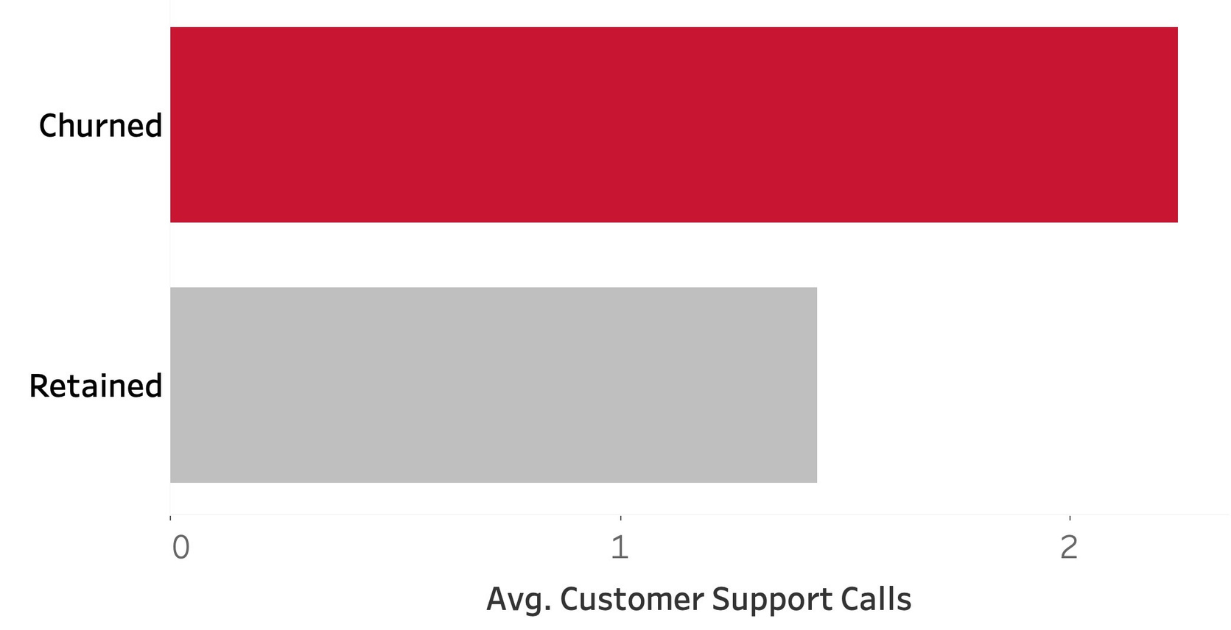
call support analysis
Customers with two or more calls tend to churn more

Slide 7
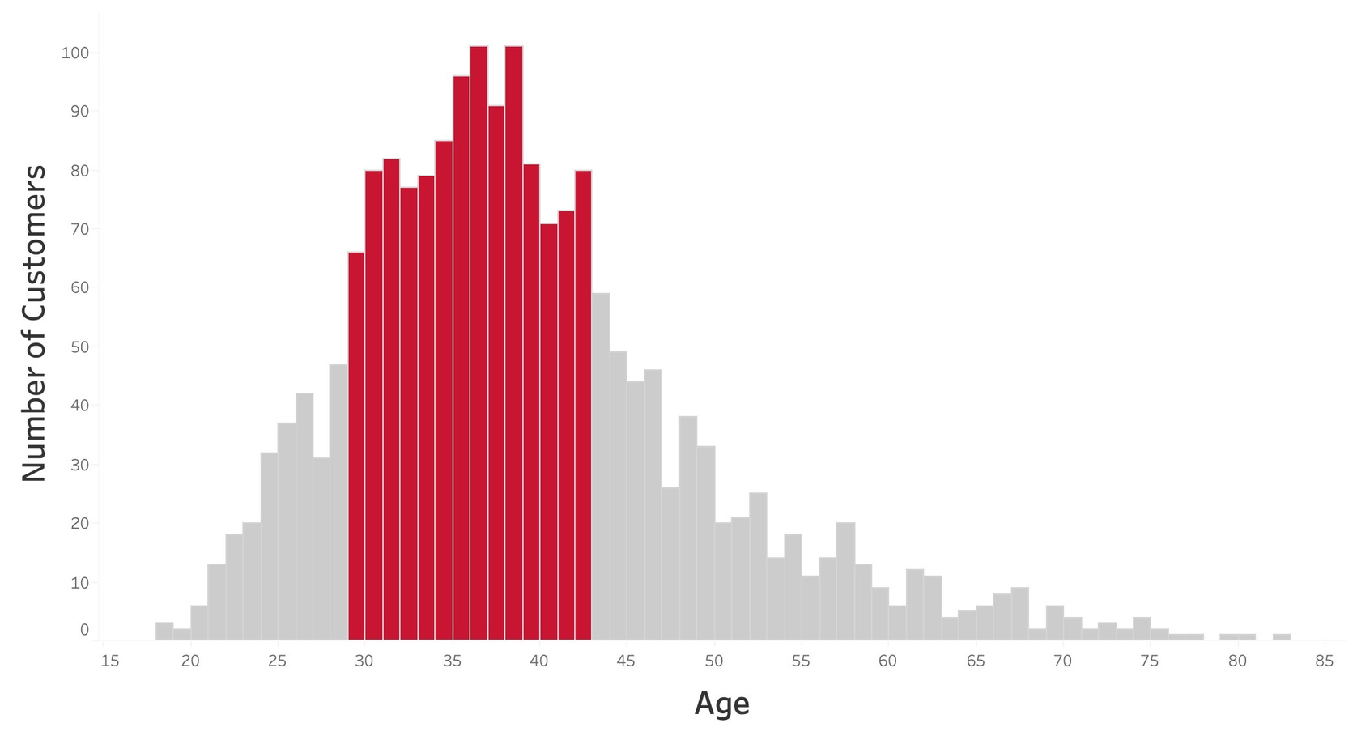
age analysis
Millennials (29-42 age bracket) form a substantial portion of our customer base

Slide 8
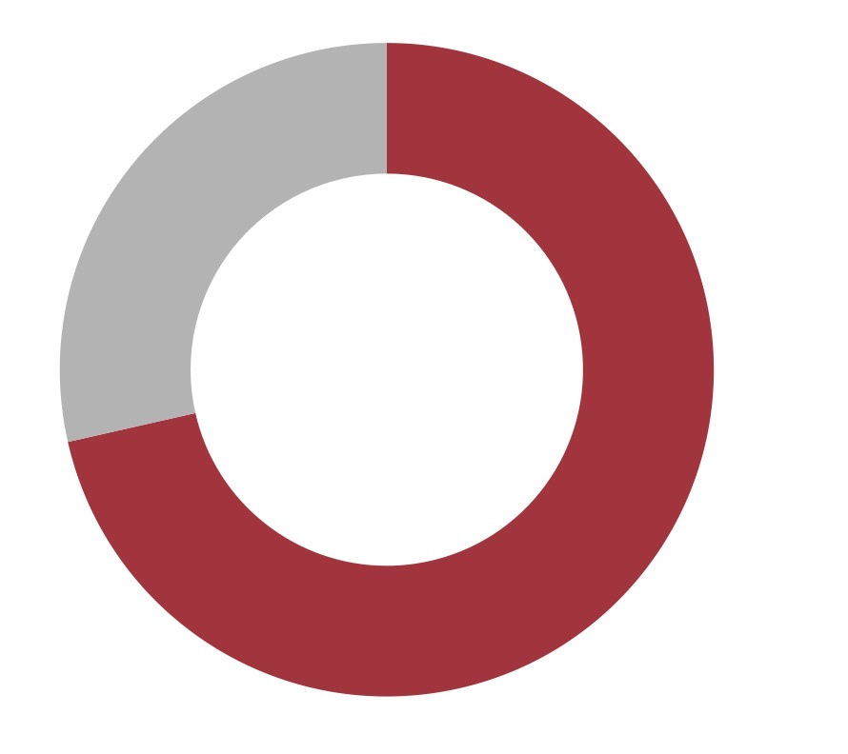
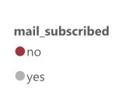
email subscriptions
71.45%
A staggering number of customers are missing out on our email subscriptions!

Slide 9

recommendations
Tailor content to cater to millennials
Expand call centers with a focus on quality; conduct a survey for specific criteria
Amplify engagement by featuring upcoming trailers, top-rated content, and news on our main website
Promote multi-screen options in Asian and African countries to retain family-based subscribers

Slide 10



Thank you !
Keep on Bingeing!!!

